Slide 1
Technology
Doug Ash, Don Thomson (TaiRox)

Slide 2
Technology – This session
Past
Present
Business considerations
Future

Slide 3
Past
Moore’s Law – number of transistors doubles every 2 years from 1965 – now
Size of atoms is the barrier

Slide 4
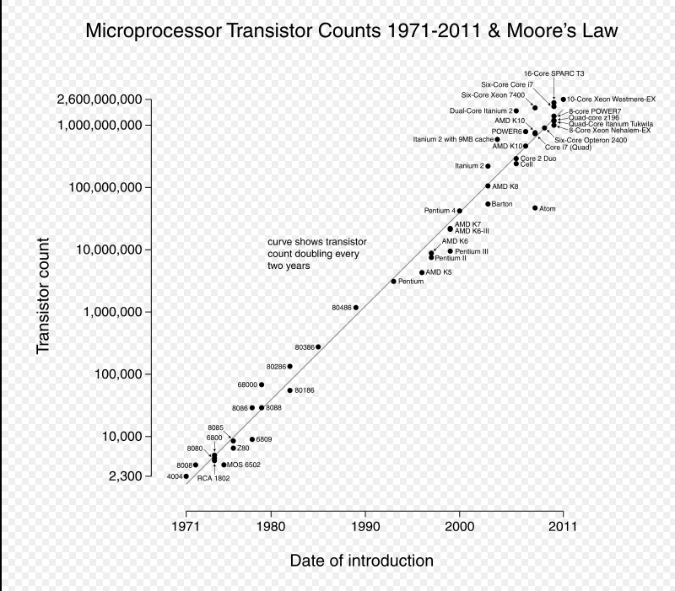

Slide 5
Past
Few number of large devices to large number of small devices

Slide 6
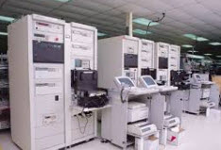
Mainframes – late 60s
Central control
Entry via Card Decks
IBM
Paper output no User monitors

Slide 7
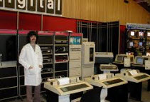
Mini Computers 70s
Central control
Entry via keyboard
Mono color monitor
No graphics
PDP11

Slide 8
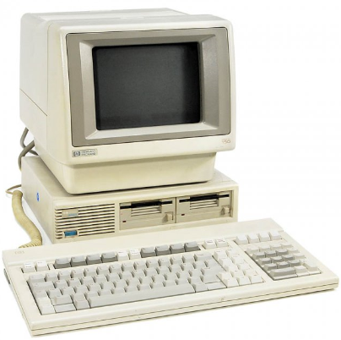
PC – 80s - DOS
Power to the people
Entry via keyboard
Mono monitor
text

Slide 9
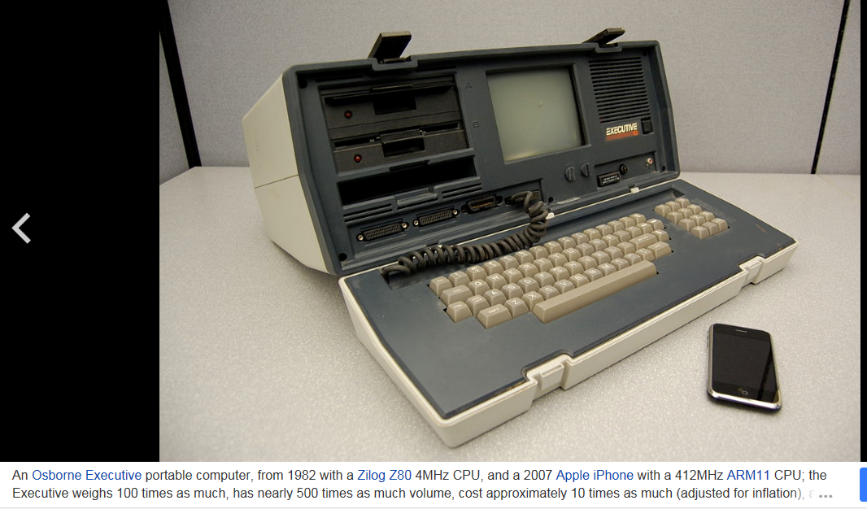

Slide 10
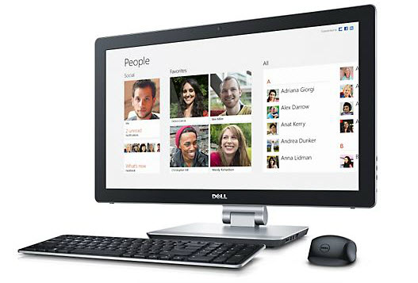
PC – 90s – present - Windows
Entry via keyboard, mouse and touch
Color monitors
Graphics
Multiple tasks.

Slide 11
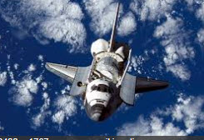
We have more computing power in our pockets that the Space Shuttle Had
8088 processor = 5Mhz
1M RAM
2.3 GHz Processor
32G RAM

Slide 12
Future Shock
Alvin Tofler – Future Shock 1970 - born at the mid point of human evolution.
As many inventions before he was born as after.

Slide 13
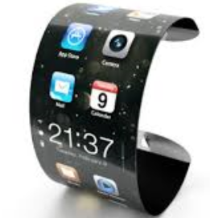
Present
3D printers – small quantity mfg
Self driving cars – new laws
Google Glasses 25” screen 8’ away
Wearable devices
Smart phones
Email on phones – always at work
Google translate – smaller planet
Siri / Google voice search
Airplane auto pilot
Industrial robots

Slide 14
Current Hardware
Dell Desktop $200 4G RAM, 500G drive
Samsung Galaxy 1.5G dual core processor, 3G RAM, 128G SSD 5.5 x 3 x 1/4 inches
500G processors – in the lab
Super computer with 3 times the “neurons” than human brain uses 24Giga watts of power

Slide 15
What my Smart Phone does for me
Email and texting
GPS and Google Maps
Camera – still and video
Entertainment
Calculator
Book reader
Contact list
Appointments
Banking
Sports tracking
Web surfing
Skype
Flashlight
Remote desktop
And its also a phone

Slide 16
Business considerations
Paperless office
Mobile / wireless devices
Instant communications
More integration – more M2M
Cheap disk space – never purge history
BI – real intelligence
Browser apps – poor standardization
Mobile Apps – OS specific
Security
Manufacturing automation – order to delivery
iPay - integration

Slide 17
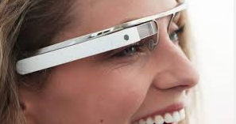
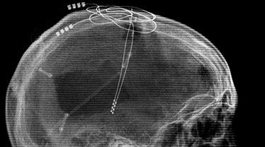
Future - What is coming
Google Glass – always online everywhere.
Lower roaming charges
More Business Apps
House Keys
Robots
Brain Implants (hmmm?)

Slide 18
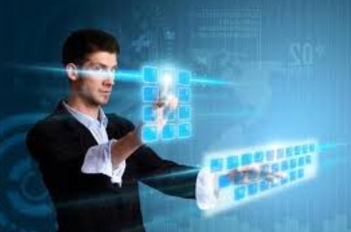
Bigger “screens”
Exponentially more data
Need better tools
Learn new interface

Slide 19
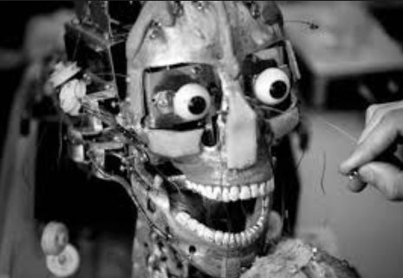
Robots - household

Slide 20
Microsoft’s vision of the future
https://www.youtube.com/watch?v=6yWzKvQXsYM

Slide 21
Questions??

Slide 22
Exhibit Centre
3-6:30 pm
Passport – get each developer to sign their logo
Entry for prizes tomorrow

Slide 23
Event Tonight
7:00 pm
Rainbow room – top of Crowne Plaza – next tower
Connect at ground level or at UL

Slide 24
Technology Thank You for attending.

